Slide 1
Z534: Search Yelp Dataset Challenge
Sanjana Agarwal
Supreeth Suryaprakash
Raghuveer Krishnamurthy
Suhas Jagadish

Slide 2
Task 1: Predict the label of each business using user “Review” and “Tip” information.
Data preprocessing:
Converted the json files to csv and extracted only the relevant information. For example, extracted ‘review text’ and ‘business_id’ from reviews, ‘business_id’ and ‘category’ from business.
Compared the business and review files to extract just the ‘Review/tip Text’ and ‘Category’.
Category field is a list of keyword, i.e., ['Fast Food', 'Restaurants'] or ['Gluten-Free', 'Asian Fusion', 'Chinese', 'Restaurants']

Slide 3
We made a list of possible categories and a map of keywords to categories, so that we would get a defined category for each business.
For example, the list ['Gluten-Free', 'Asian Fusion', 'Chinese', 'Restaurants'] would be mapped to ‘Chinese’ category or ['Burgers', 'Fast Food', 'Restaurants'] would be mapped to ‘American’.
Once the final file is generated, we use that to train our model. We employ a supervised learning approach using KNN and Multiclass SVM.
We use the Bag of Words model, coupled with TF-IDF vectorization to generate the model file.

Slide 4
Bag of Words and TF-IDF:
Rather than using the existing libraries to create the bag of words and calculate the TF-IDF, we decided to do these tasks from scratch.
We split each review, tokenized it, removed the stop words and created a bag of words, that has been used as our features.
The model file can be thought of as a 2D matrix where x-axis represents each review, y-axis represents the features (bag of words) and the value is the TF-IDF value of the word.
The formula used to compute the TF-IDF is:
tf-idf(d, t)=tf(t)*idf(d, t)
where tf(t) = c(t, doc)/length(doc) and idf(d, t) = log(1+ N/k(t))
Once the TF-IDF values are generated, we create the model file and pass it on to KNN and Multiclass SVM algorithms.

Slide 5
Evaluation:
We divide our dataset in the ratio 70-30 where 70% of the data is used to train the model and 30% to test it.
We use 5-fold cross validation to evaluate the results on the test set.
We determine precision, recall and F1-score for each class label and finally compute the accuracy of our model.
Results:
With KNN, we achieved an accuracy of 82.84%
We experimented with different values of k={2, 4, 6, 8,10} and we found the highest accuracy rating with k=4. (where k is the number of neighbors)
With Multiclass SVM, we achieved an accuracy of 76.92%

Slide 6
Evaluation metrics:
Algorithm | Precision | Recall | Accuracy
KNN | 0.82 | 0.83 | 82.84%
Multiclass SVM | 0.59 | 0.77 | 76.92%

Slide 7
Task 2: Personalization of User’s Dashboard.
What are we doing?
Suggesting similar Users to follow.
Predicting the User’s favorite neighborhood.
Predicting User’s favorite Category.
Suggest top rated businesses in his preferred category and neighborhood.
Predicting possible restaurants he might go to.
Data Preprocessing:
Converted User reviews to Binary Values.
Removed Noise in training data.
Decoded Unicode values for strings. For e.g. Montréal

Slide 8
Find Similar Users to Follow
Spearman Ranking correlation.
We pick top 25 followers with highest correlation.
Predict User’s Favorite Category
Z-Score Normalization
Normalize each rating and finding out which category the User has liked the most.
Predict User’s Favorite Neighborhood
By finding out the User’s check-ins across the Country and taking the cluster with maximum data points as his favorite neighborhood.

Slide 9
Suggest Businesses
Making use of the above two results, We’ll suggest top businesses that he/she can visit.
Take top rated businesses based on User ratings/reviews.
Things taken into consideration,
Most preferred Neighborhood.
Most preferred Category.

Slide 10

Predict Businesses with HMM
Building a HMM where the observed states are the categories and the reviews are the hidden variables
Calculate the ⍺_{t}(x_{t}) using p(y_{t}|x_{t}) i.e, emission probability, p(x_{t}|x_{t-1}) i.e, transition probability and ⍺_{t-1}(x_{t-1}), the message propagated from previous state.
The resulting ⍺_{t} is the probability of a certain category having a good / bad review based on User history.

Slide 11
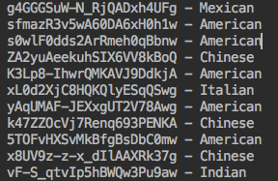
Sample Output:
Similar Users:
Favorite Category:

Slide 12
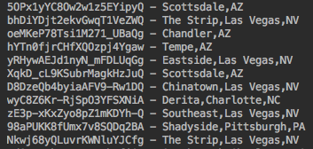
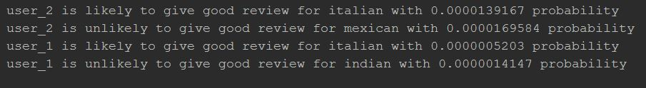
Most Preferred Neighborhood:
Business Prediction with HMM:

Slide 13
Evaluation Metrics:
We use Normalized Discounted Cumulative Gain (NDCG) to evaluate the accuracy of our Prediction model.
For Each User we have a ranking vector which has top rankings for Followers, Neighborhood and Categories.
Using MAE to calculate the Error of our Prediction model.

Slide 14
Teams:
Task 1:
Data Processing – Suhas
Approach(BOW, TF-IDF, KNN, SVM) – Suhas and Sanjana
Evaluation – Suhas and Sanjana
Task 2:
Data processing – Supreeth and Raghuveer
Approach (HMM) – Raghuveer
Approach (Most liked Category, Neighborhood, potential followers, suggesting Restaurants) – Supreeth
Evaluation – Supreeth and Raghuveer

